Slide 1
Quicksort Algorithm

Slide 2
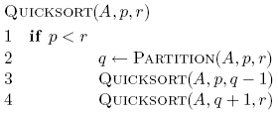
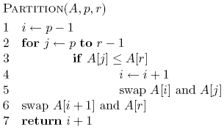
Quicksort

Slide 3
8 5 1 3 6 2 7 4

Slide 4
8 5 1 3 6 2 7 4

Slide 5
1 3 2 4 6 8 7 5

Slide 6
1 3 2 4 6 8 7 5

Slide 7
1 3 2 4 6 8 7 5

Slide 8
1 2 3 4 6 8 7 5

Slide 9
1 2 3 4 6 8 7 5

Slide 10
1 2 3 4 6 8 7 5

Slide 11
1 2 3 4 6 8 7 5

Slide 12
1 2 3 4 6 8 7 5

Slide 13
1 2 3 4 5 8 7 6
What happens here?

Slide 14
1 2 3 4 5 8 7 6

Slide 15
1 2 3 4 5 8 7 6

Slide 16
1 2 3 4 5 6 7 8

Slide 17
1 2 3 4 5 6 7 8

Slide 18
Some observations
Divide and conquer: different than MergeSort – do the work before recursing
How many times is/can an element selected for as a pivot?
What happens after an element is selected as a pivot?
1 3 2 4 6 8 7 5

Slide 19
Is Quicksort correct?
Assuming Partition is correct
Proof by induction
  Base case: Quicksort works on a list of 1 element
  Inductive case:
    Assume Quicksort sorts arrays for arrays of smaller < n elements, show that it works to sort n elements
    If partition works correctly then we have:
    and, by our inductive assumption, we have:
pivot
A
sorted
sorted
≤ pivot
> pivot

Slide 20
Running time of Quicksort?
Worst case?
Each call to Partition splits the array into an empty array and n-1 array

Slide 21
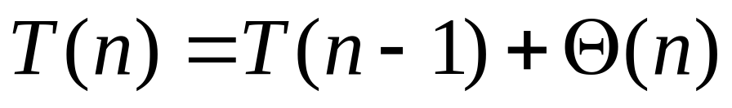
Quicksort: Worse case running time
Which is?
Θ(n²)
When does this happen?
  sorted
  reverse sorted
  near sorted/reverse sorted

Slide 22
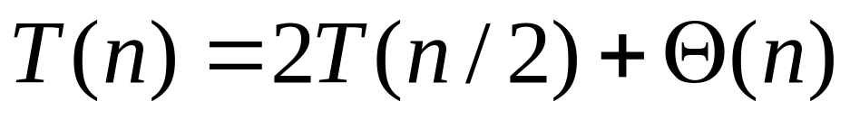
Quicksort best case?
Each call to Partition splits the array into two equal parts
O(n log n)
When does this happen?
  random data
  ?

Slide 23
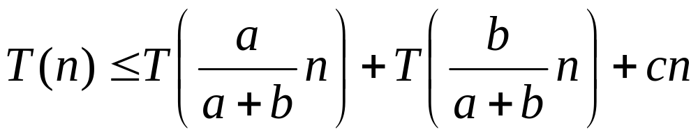
Quicksort Average case?
How close to “even” splits do they need to be to maintain an O(n log n) running time?
Say the Partition procedure always splits the array into some constant ratio b-to-a, e.g. 9-to-1
What is the recurrence?

Slide 24
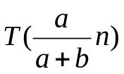
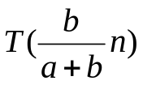
cn

Slide 25
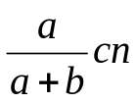
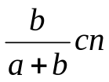
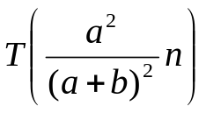
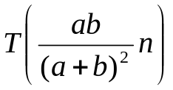
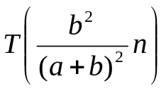
cn

Slide 26
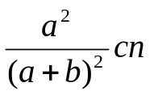
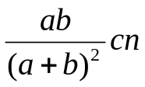
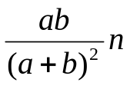
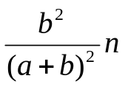





cn

Slide 27

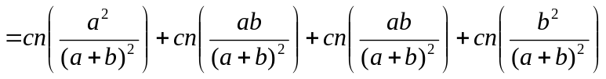
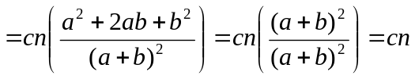
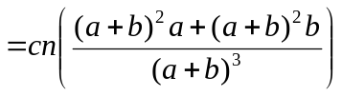
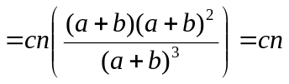
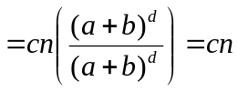
Level 0: cn
Level 1:
Level 2:
Level 3:
Level d:

Slide 28
What is the depth of the tree?
Leaves will have different heights
Want to pick the deepest leave
Assume a < b

Slide 29
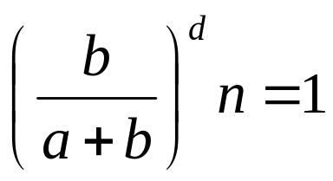
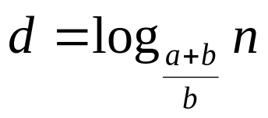
What is the depth of the tree?
Assume a < b
…

Slide 30
Cost of the tree
Cost of each level ≤ cn
?

Slide 31
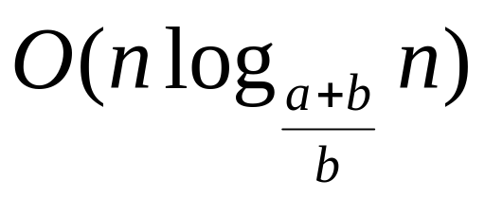
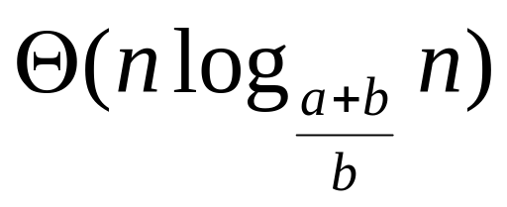
Cost of the tree
Cost of each level ≤ cn
Times the maximum depth
Why not?

Slide 32
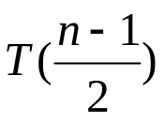
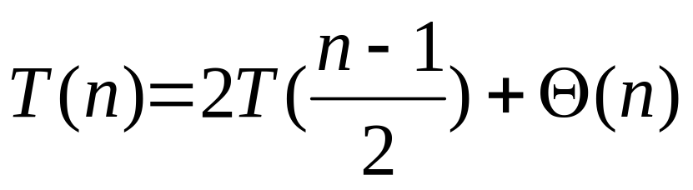
Quicksort average case: take 2
What would happen if half the time Partition produced a “bad” split and the other half “good”?
“good” 50/50 split
cn

Slide 33


Quicksort average case: take 2
cn
“bad” split

Slide 34

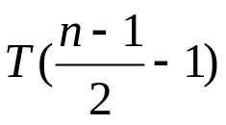
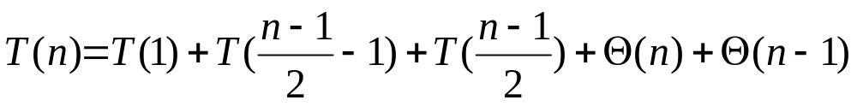
Quicksort average case: take 2
cn
“bad” split
“good” 50/50 split
recursion cost
partition cost

Slide 35
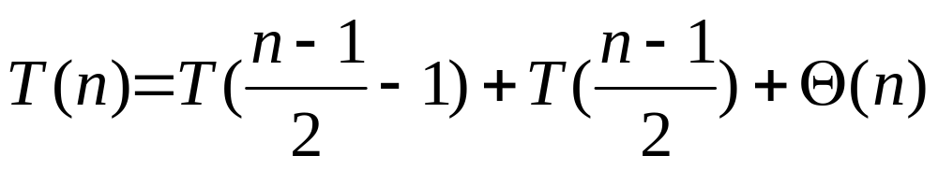
Quicksort average case: take 2
cn
“bad” split
“good” 50/50 split
We absorb the “bad” partition. In general, we can absorb any constant number of “bad” partitions

Slide 36

How can we avoid the worst case?
Inject randomness into the data

Slide 37
What is the running time of randomized Quicksort?
Worst case?
Still could get very unlucky and pick “bad” partitions at every step
O(n²)

Slide 38
randomized Quicksort: expected running time
How many calls are made to Partition for an input of size n?
What is the cost of a call to Partition?
Cost is proportional to the number of iterations of the for loop
n
the total number of comparisons will give us a bound on the running time

Slide 39
Counting the number of comparisons
Let z_{i} of z₁, z₂,…, z_{n} be the i th smallest element
Let Z_{ij} be the set of elements Z_{ij}= z_{i}, z_{i+1},…, z_{j}
A = [3, 9, 7, 2]
z₁ = 2
z₂ = 3
z₃ = 7
z₄ = 9
Z₂₄ =

Slide 40
Counting the number of comparisons
Let z_{i} of z₁, z₂,…, z_{n} be the i th smallest element
Let Z_{ij} be the set of elements Z_{ij}= z_{i}, z_{i+1},…, z_{j}
A = [3, 9, 7, 2]
z₁ = 2
z₂ = 3
z₃ = 7
z₄ = 9
Z₂₄ = [3, 7, 9]

Slide 41
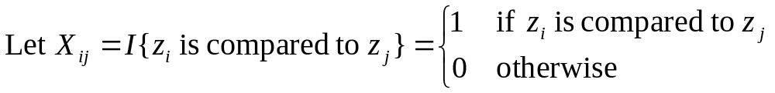
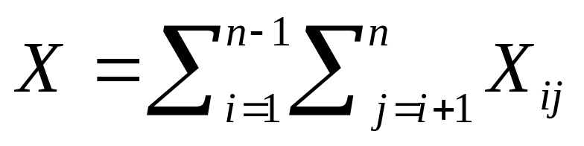
Counting comparisons
(indicator random variable)
How many times can z_{i} be compared to z_{j}?
At most once. Why?
Total number of comparisons

Slide 42
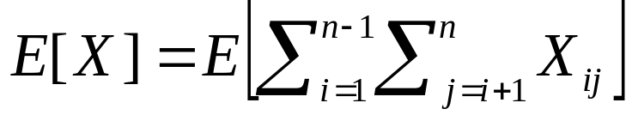
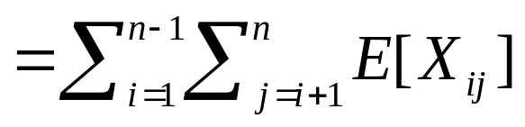
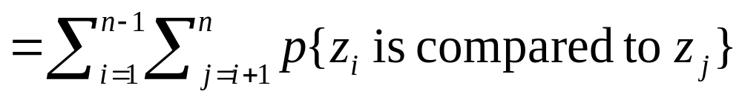
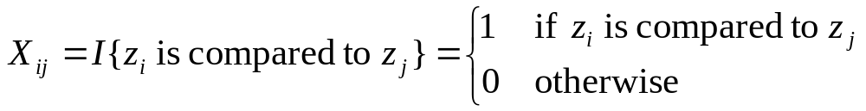
Counting comparisons: average running time
expectation of sums is the sum of expectations
remember,

Slide 43
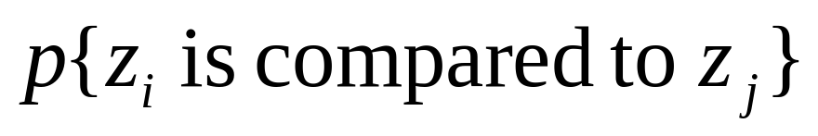
?
The pivot element separates the set of numbers into two sets (those less than the pivot and those larger). Elements from one set will never be compared to elements of the other set
If a pivot x is chosen z_{i} < x < z_{j} then z_{i} and z_{j} how many times will z_{i} and z_{j} be compared?
What is the only time that z_{i} and z_{j} will be compared?
In Z_{ij}, when will z_{i} and z_{j} will be compared?

Slide 44


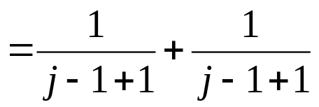
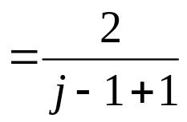
?
p(a,b) = p(a)+p(b) for independent events
pivot is chosen randomly over j-i+1 elements

Slide 45
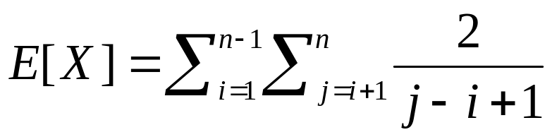
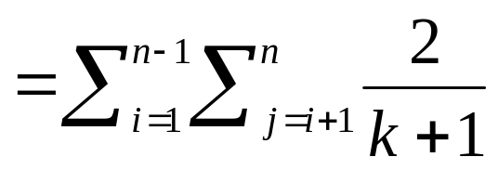
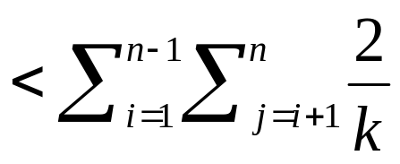
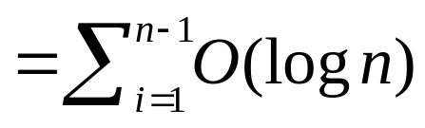
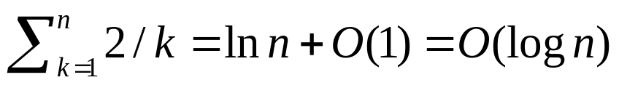

E[X] ?
Let k = j-i

Slide 46
Memory usage?
Quicksort only uses O(1) additional memory
How does randomized Quicksort compare to Mergesort?

Slide 47
Medians
The median of a set of numbers is the number such that half of the numbers are larger and half smaller
How might we calculate the median of a set?
Sort the numbers, then pick the n/2 element
A = [50, 12, 1, 97, 30]

Slide 48
Medians
The median of a set of numbers is the number such that half of the numbers are larger and half smaller
How might we calculate the median of a set?
Sort the numbers, then pick the n/2 element
A = [50, 12, 1, 97, 30]
A = [1, 12, 30, 50, 97]
Θ(n log n)

Slide 49
Medians
Can we do better? By sorting the data, it seems like we’re doing more work than we need to.
Partition takes Θ(n) time and performs a similar operation
Selection problem: find the kth smallest element of A
If we could solve the selection problem, how would this help us?

Slide 50
Selection: divide and conquer
Partition splits the data into 3 sets:
those < A[q], = A[q] and > A[q]
With each recursive call, we can narrow the search in to one of these sets
Like binary search on unsorted data
Selection(A, k, p, r)
q <- Partition(A,p,r)
if k = q
Return A[q]
else if k < q
Selection(A, k, p, q-1)
else // k > q
Selection(A, k, q+1, r)

Slide 51
Selection(A, 3, 1, 8)
5 7 1 4 8 3 2 6
Selection(A, k, p, r)
q <- Partition(A,p,r)
if k = q
Return A[q]
else if k < q
Selection(A, k, p, q-1)
else // k > q
Selection(A, k, q+1, r)

Slide 52
Selection(A, 3, 1, 8)
5 1 4 3 2 6 8 7
Selection(A, k, p, r)
q <- Partition(A,p,r)
if k = q
Return A[q]
else if k < q
Selection(A, k, p, q-1)
else // k > q
Selection(A, k, q+1, r)

Slide 53
Selection(A, 3, 1, 8)
5 1 4 3 2 6 8 7
Selection(A, k, p, r)
q <- Partition(A,p,r)
if k = q
Return A[q]
else if k < q
Selection(A, k, p, q-1)
else // k > q
Selection(A, k, q+1, r)

Slide 54
Selection(A, 3, 1, 8)
5 1 4 3 2 6 8 7
At each call, discard part of the array
Selection(A, k, p, r)
q <- Partition(A,p,r)
if k = q
Return A[q]
else if k < q
Selection(A, k, p, q-1)
else // k > q
Selection(A, k, q+1, r)

Slide 55
Selection(A, 3, 1, 8)
1 2 4 3 5 6 8 7
Selection(A, k, p, r)
q <- Partition(A,p,r)
if k = q
Return A[q]
else if k < q
Selection(A, k, p, q-1)
else // k > q
Selection(A, k, q+1, r)

Slide 56
Selection(A, 3, 1, 8)
1 2 4 3 5 6 8 7
Selection(A, k, p, r)
q <- Partition(A,p,r)
if k = q
Return A[q]
else if k < q
Selection(A, k, p, q-1)
else // k > q
Selection(A, k, q+1, r)

Slide 57
Selection(A, 3, 1, 8)
1 2 4 3 5 6 8 7
Selection(A, k, p, r)
q <- Partition(A,p,r)
if k = q
Return A[q]
else if k < q
Selection(A, k, p, q-1)
else // k > q
Selection(A, k, q+1, r)

Slide 58
Selection(A, 3, 1, 8)
1 2 4 3 5 6 8 7
Selection(A, k, p, r)
q <- Partition(A,p,r)
if k = q
Return A[q]
else if k < q
Selection(A, k, p, q-1)
else // k > q
Selection(A, k, q+1, r)

Slide 59
Selection(A, 3, 1, 8)
1 2 4 3 5 6 8 7
Selection(A, k, p, r)
q <- Partition(A,p,r)
if k = q
Return A[q]
else if k < q
Selection(A, k, p, q-1)
else // k > q
Selection(A, k, q+1, r)

Slide 60
Selection(A, 3, 1, 8)
1 2 4 3 5 6 8 7
Selection(A, k, p, r)
q <- Partition(A,p,r)
if k = q
Return A[q]
else if k < q
Selection(A, k, p, q-1)
else // k > q
Selection(A, k, q+1, r)

Slide 61
Selection(A, 3, 1, 8)
1 2 3 4 5 6 8 7
Selection(A, k, p, r)
q <- Partition(A,p,r)
if k = q
Return A[q]
else if k < q
Selection(A, k, p, q-1)
else // k > q
Selection(A, k, q+1, r)

Slide 62
Selection(A, 3, 1, 8)
1 2 3 4 5 6 8 7
Selection(A, k, p, r)
q <- Partition(A,p,r)
if k = q
Return A[q]
else if k < q
Selection(A, k, p, q-1)
else // k > q
Selection(A, k, q+1, r)

Slide 63
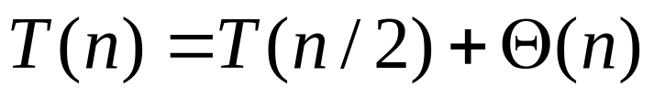
Running time of Selection?
Best case?
Each call to Partition throws away half the data
Recurrence?
O(n)

Slide 64

Running time of Selection?
Worst case?
Each call to Partition only reduces our search by 1
Recurrence?
O(n²)

Slide 65
How can randomness help us?
RSelection(A, k, p, r)
q <- RPartition(A,p,r)
if k = q
Return A[q]
else if k < q
Selection(A, k, p, q-1)
else // k > q
Selection(A, k, q+1, r)

Slide 66
Running time of RSelection?
Best case
  O(n)
Worst case
  Still O(n²)
  As with Quicksort, we can get unlucky
Average case?

Slide 67
Average case
Depends on how much data we throw away at each step

Slide 68
Average case
We’ll call a partition “good” if the pivot falls within within the 25th and 75th percentile
Or, each of the partions contains at least 25% of the data
What is the probability of a “good” partition?
Half of the elements lie within this range and half outside, so 50% chance

Slide 69
Average case
Recall, that like Quicksort, we can absorb the cost of a number of “bad” partitions

Slide 70
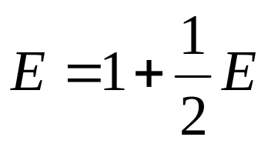
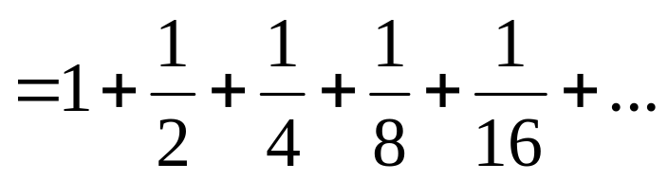

Average case
On average, how many times will Partition need to be called before be get a good partition?
Let E be the number of times
Recurrence:
half the time we get a good partition on the first try and half of the time, we have to try again

Slide 71
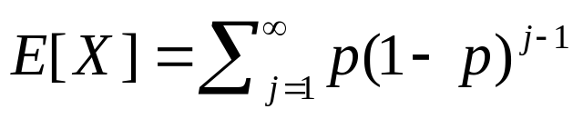
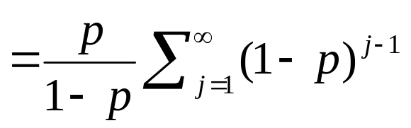
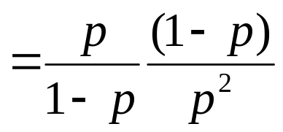

Average case
Another look. Let p be the probability of success
Let X be the number of calls required

Slide 72

Average case
?
roll in the cost of the “bad” partitions

Slide 73
Average case
We throw away at least ¼ of the data
roll in the cost of the “bad” partitions

Slide 74
Randomized algorithms
We used randomness to minimize the possibility of worst case running time
Other uses
  approximation algorithms, i.e. random walks
  initialization, e.g. K-means clustering
  contention resolution
  reinforcement learning/interacting with an ill-defined world

